Slide 1

Reviewing Performance During Response Operations:
Intra-Action Review

Slide 2

Objectives
This presentation is intended to:
Explain what is an Intra-Action Review
Describe its scope and phases
Define steps and expected activities

Slide 3
Intra-Action Review
An Intra-Action Review (IAR) is a country-led qualitative review of the actions taken during the response of an ongoing emergency (e.g., COVID-19).
It is done through a facilitated discussion that allows stakeholder of the response to:
Identify gaps, lessons and best practices to improve a response plan.
Propose corrective actions to improve and strengthen the continued response.
Contribute to improving the management of concurrent health emergencies.

Slide 4
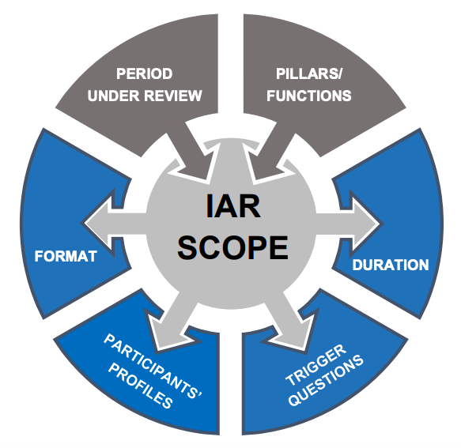
Scope
Prior to beginning the IAR, the authority requesting the IAR should define its scope to facilitate the process.
It should also define:
Period to be examined.
Response pillars to be reviewed.
Number and profiles of participants.
Duration of the review and the format.
Trigger questions to be used.
WHO, 2020

Slide 5
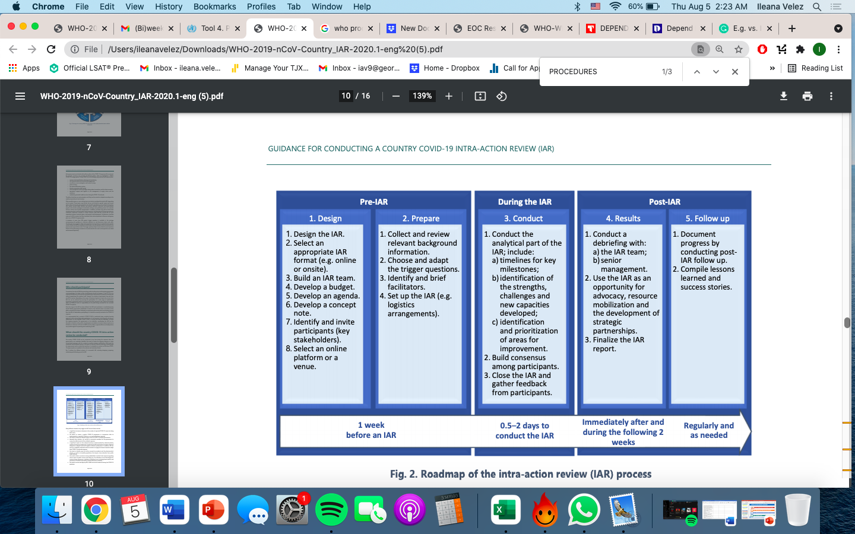
Phases of an IAR
An IAR must go through different phases to ensure that it is successfully done.
Within each phase there are categories with specific activities that need to me completed.
Pre-IAR: Design and Prepare
During IAR: Conduct
Post-IAR: Results and Follow up
WHO, 2020

Slide 6
Intra-Action Review Overview:
COVID-19

Slide 7
COVID-19 Intra-Action Review Overview
Overview of Response
Step 1: What went well so far? What went wrong?
Step 2: What can we do to improve the COVID-19 response?
Step 3: The path forward

Slide 8
Overview of the Response
A description of the COVID-19 response is necessary to effectively evaluate it through an IAR.
It is suggested that the following information is presented to begin the process:
Overview of existing capacities prior to COVID-19 response.
Capacities developed for and during the COVID-19 response.
Response strategy.
Response timeline during the period under review.

Slide 9
Step 1: What went well? What went wrong?
Step 1 calls for the analysis of the actions taken during the COVID-19 response. Identifying the strengths, challenges, and the contributing factors to the outcome are essential to the process.
The discussion should consider:
Coordination
Roles and Responsibilities
Coordination among health sector and outside health sector
National/Regional/Local level coordination

Slide 10
Step 1: What went well? What went wrong? (continued)
Resources
Human resources capacity
Relevance of plans and procedures
Financial and material resource requirements

Slide 11
Step 2: What can we do to improve the COVID-19 response?
Step 2 uses the previous discussion to institutionalize best practices and overcome challenges.
A plan with specific activities should be developed based on the identified best practices and challenges.
It should build on enabling factors and address limiting factors.
Activities must be practical and realistic.
Not all best practices or challenges need an activity.

Slide 12
Step 3: The path forward
Step 3 determines what the future of the COVID-19 response would be. This will depend on the:
Identification on what can be done immediately to improve ongoing responses efforts and what can be done in the mid and long-term to improve the future response to the next wave of the COVID-19.
Establishment of an IAR Follow-up team.
Documentation of progress in implementing recommendations and completing activities.

Slide 13

References
WHO (2020). Guidance for conducting a country COVID-19 intra-action review (IAR). https://www.who.int/publications/i/item/WHO-2019-nCoV-Country_IAR-2020.1
WHO (2021). Tool 4. Presentation template. https://www.who.int/publications/i/item/WHO-2019-nCoV-Country-IAR-templates-presentation-2021.1
WHO (2021). Intra-Action Review: A Video Overview. https://extranet.who.int/sph/intra-action-review
Greiner, A et al. (2021). COVID-19 intra-action reviews: potential for a sustained response plan. Lancet Global Health 9(5), E594. https://doi.org/10.1016/S2214-109X(21)00078-4
Houser, R (2021). Intra Action Reviews as a New Tool in Public Health Emergency Management and Pandemic Response: A Summary of Uses and Applications, 2020-2021. https://epidemic-em.org/case-studies/
Georgetown Center for Global Health Science & Security

